Slide 1
Network flow
Is it more important than before?

Slide 2
Introduction – network
Practical examples of a network
  liquids flowing through pipes
  parts through assembly lines
  current through electrical network
  information through communication network
  goods transported on the road…

Slide 3

Representation
Example: oil pipeline
Definition 9.1 Flow network:
directed graph G=(V,E)
v₁
v₃
v₁
v₃
s
t
s
t
v₂
v₄
source
v₂
v₄
sink

Slide 4
Max-flow problem
Representation
Example: oil pipeline
Definition 9.1 Flow network:
directed graph G=(V,E)
v₁
v₃
v₁
v₃
s
t
s
t
v₂
v₄
source
v₂
v₄
sink
Informal definition of the max-flow problem:
What is the greatest rate at which material can be shipped from the source to the sink without violating any capacity contraints?

Slide 5
Capacity
Flow network:
directed graph G=(V,E)
Example: oil pipeline
3
v₁
v₃
v₁
v₃
6
8
3
s
t
s
t
3
6
v₂
v₄
8
6
v₂
v₄
12
u
v
c(u,v)=12
Big pipe
u
6
v
c(u,v)=6
Small pipe

Slide 6
Flow network:
directed graph G=(V,E)
Example: oil pipeline
3
v₁
v₃
v₁
v₃
6
8
3
s
t
s
t
3
6
v₂
v₄
8
6
v₂
v₄
If (u,v) ∉ E ⇒ c(u,v) = 0
6
v₂
v₄
0
0
v₄
v₃
0

Slide 7
Flow
Flow network:
directed graph G=(V,E)
Example: oil pipeline
3
v₁
v₃
v₁
v₃
6
8
3
s
t
s
t
3
6
v₂
v₄
8
6
v₂
v₄
6/12
u
v
f(u,v)=6
Flow below capacity
u
6/6
v
f(u,v)=6
Maximum flow

Slide 8
Flow
Flow network:
directed graph G=(V,E)
Example: oil pipeline
3
v₁
v₃
v₁
v₃
6
8
3
s
t
s
t
3
6
v₂
v₄
8
6
v₂
v₄

Slide 9
Flow network:
directed graph G=(V,E)
Example: oil pipeline
3
v₁
v₃
v₁
v₃
6
8
3
s
t
s
t
3
6/6
6/8
v₂
v₄
v₂
v₄
6/6

Slide 10
Flow network:
directed graph G=(V,E)
Example: oil pipeline
3
v₁
v₃
v₁
v₃
3
6
8
s
t
s
t
3
6/6
v₂
v₄
6/8
v₂
v₄
6/6

Slide 11
Flow network:
directed graph G=(V,E)
Example: oil pipeline
3/3
v₁
v₃
v₁
v₃
3/6
3/8
3
s
t
s
t
3
6/6
6/8
v₂
6/6
v₄
v₂
v₄

Slide 12
Flow network:
directed graph G=(V,E)
Example: oil pipeline
3/3
v₁
v₃
v₁
v₃
3/6
3/8
3
s
t
s
t
3
6/6
6/8
v₂
v₄
v₂
6/6
v₄

Slide 13
Flow network:
directed graph G=(V,E)
Example: oil pipeline
3/3
v₁
v₃
v₁
v₃
3/6
5/8
2/3
s
t
s
t
3
6/6
v₂
v₄
8/8
v₂
v₄
6/6

Slide 14
Flow network:
directed graph G=(V,E)
Example: oil pipeline
3/3
v₁
v₃
v₁
v₃
5/8
3/6
2/3
s
t
s
t
3
6/6
v₂
v₄
8/8
v₂
v₄
6/6

Slide 15
Cancellation
Flow network:
directed graph G=(V,E)
Example: oil pipeline
3/3
v₁
v₃
v₁
v₃
4/6
6/8
3/3
s
t
s
t
1/3
6/6
8/8
v₂
5/6
v₄
v₂
v₄
u
u
u
u
10
4
4
8/10
3/4
5/10
8/10
4
v
v
v
v

Slide 16
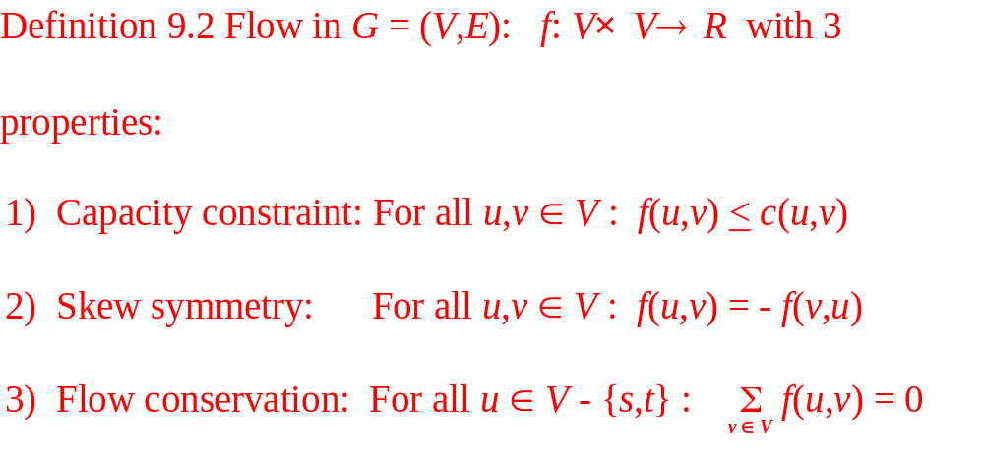
Flow properties

Slide 17
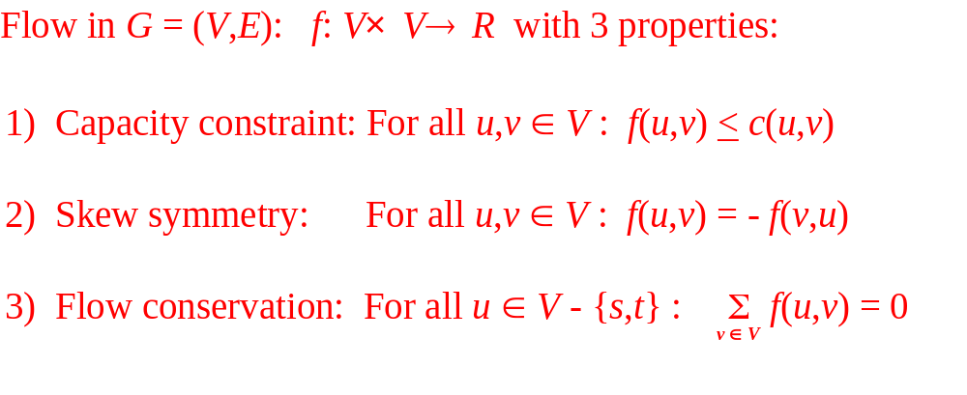
Flow properties
Flow network G = (V,E)
v₁
12/12
v₃
Note:
by skew symmetry
f(v₃,v₁) = - 12
11/16
15/20
10
1/4
7/7
s
4/ 9
t
4/4
8/13
v₂
v₄
11/14

Slide 18
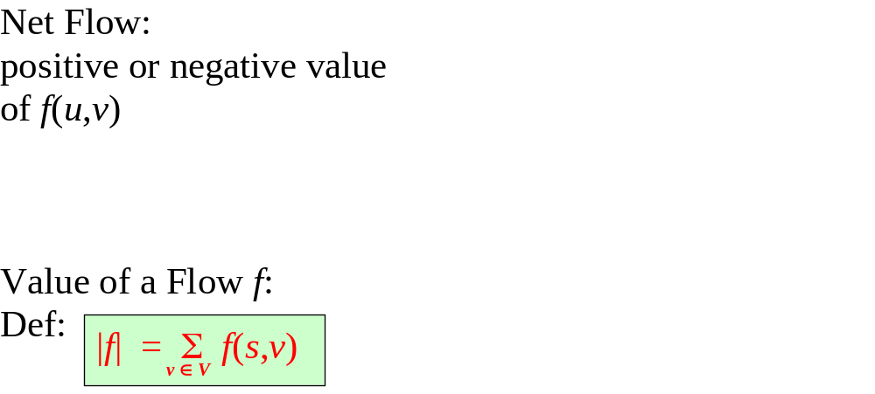
Net flow and value of a flow
u
u
f(u,v) = 5
f(v,u) = -5
8/10
3/4
5/10
4
v
v
3/3
v₁
v₃
6/8
4/6
3/3
s
t
1/3
6/6
v₂
v₄
8/8
5/6

Slide 19
The max-flow problem
Informal definition of the max-flow problem:
What is the greatest rate at which material can be shipped from the source to the sink without violating any capacity contraints?
Formal definition of the max-flow problem:
The max-flow problem is to find a valid flow for a given weighted directed graph G, that has the maximum value over all valid flows.

Slide 20
The Ford-Fulkerson method a way how to find the max-flow
This method contains 3 important ideas:
1) residual networks
2) augmenting paths
3) cuts of flow networks

Slide 21
Residual networks
Definition 9.3 Given a flow f on G with capacity function c, the residual capacity function for f on the set of paris of vertices is defined as follows:For each pair of vertices u,v∈V, c_{f}(u,v)=c(u,v) –f(u,v), the residual graph for f is the direct graph Gf=(V, E_{f} ), with capacities defined by c_{f} and E_{f} ={(u,v)|c_{f} (u,v)>0}
Flow network G = (V,E)
residual network G_{f} =(V,E_{f})
v₁
12/12
v₃
5
v₁
v₃
11/16
15/20
11
10
1/4
7/7
s
4/9
t
s
t
5
4/4
8/13
v₂
v₄
8
v₂
v₄
11/14
c_{f}(u,v) = c(u,v) – f(u,v)

Slide 22
Residual networks
Definition 9.3 Given a flow f on G with capacity function c, the residual capacity function for f on the set of paris of vertices is defined as follows:For each pair of vertices u,v∈V, c_{f}(u,v)=c(u,v) –f(u,v), the residual graph for f is the direct graph Gf=(V, E_{f} ), with capacities defined by c_{f} and E_{f} ={(u,v)|c_{f} (u,v)>0}
Flow network G = (V,E)
residual network G_{f}=(V,E_{f})
v₁
12/12
v₃
v₁
12
v₃
11/16
5
5
15/20
4
11
3
10
1/4
7/7
11
7
15
s
4/9
t
s
5
t
5
4/4
4
8/13
v₂
v₄
8
v₂
3
v₄
11/14
11
c_{f}(u,v) = c(u,v) – f(u,v)

Slide 23
Augmenting paths
Definition 9.4 Given two flows f₁ and f₂ on G, let (f₁ + f₂ )(u,v)= f₁(u,v)+f₂ (u,v), f₁ + f₂ is called the sum of flows f₁ and f₂
Definition 9.5 Given a residual graph Gf=(V, E_{f} ), Augmenting path is a direct path from s to t.
Flow network G=(V,E)
Residual network G_{f}=(V,E_{f})
v₁
12/12
v₃
v₁
12
v₃
11/16
5
5
15/20
4
11
3
10
1/4
7/7
11
7
15
s
4/9
t
s
5
t
5
4/4
4
8/13
v₂
v₄
8
v₂
3
v₄
11/14
11

Slide 24
Augmenting paths
Definition 9.5 Given a residual graph Gf=(V, E_{f} ), Augmenting path is a direct path from s to t.
Residual network G_{f}=(V,E_{f})
Flow network G=(V,E)
v₁
12
v₃
v₁
12/12
v₃
5
5
11/16
15/20
11
3
4
11
7
15
10
1/4
7/7
s
5
t
s
4/9
t
5
4
4/4
8
v₂
3
8/13
v₄
v₂
v₄
11/14
11
Augmenting path

Slide 25
Augmenting paths
We define a flow: f_{p}: V×V → R such as:
c_{f} (p) if (u,v) is on p
f_{p}(u,v) = -c_{f} (p) if (v,u) is on p
0 otherwise
Where,
c_{f}(p) = min{c_{f}(u,v): (u,v) is on p}
Flow network G = (V, E)
Residual network G_{f}= (V, E_{f})
v₁
12
v₃
v₁
12/12
v₃
5
5
11/16
15/20
11
3
4
11
7
15
10
1/4
7/7
s
5
t
s
4/9
t
5
4
4/4
8
v₂
3
8/13
v₄
v₂
v₄
11/14
11
Our virtual flow f_{p} along the augmenting path p in G_{f}

Slide 26
Augmenting paths
We define a flow: f_{p}: V×V → R such as:
c_{f} (p) if (u,v) is on p
f_{p}(u,v) = -c_{f} (p) if (v,u) is on p
0 otherwise
Where,
c_{f}(p) = min{c_{f}(u,v): (u,v) is on p}
Flow network G = (V, E)
Residual network G_{f}= (V, E_{f})
v₁
12
v₃
5
4/5
v₁
12/12
v₃
11/16
11
4/4
15/20
11
3
7
-4/15
10
1/4
7/7
s
-4/5
t
s
4/9
t
4/5
4
-4/8
v₂
3
4/4
v₄
8/13
v₂
v₄
11
11/14
Virtual flow f_{p} along p in G_{f}

Slide 27
Augmenting paths
We define a flow: f_{p}: V×V → R such as:
c_{f} (p) if (u,v) is on p
f_{p}(u,v) = -c_{f} (p) if (v,u) is on p
0 otherwise
Flow network G = (V, E)
Residual network G_{f}= (V, E_{f})
v₁
12/12
v₃
v₁
12
v₃
11/16
5
4/5
19/20
4/4
11
10
1/4
7/7
11
3
7
15
s
0/9
t
s
5
t
4/5
4/4
4
12/13
v₂
v₄
8
v₂
3
v₄
11/14
11
New flow:
f ´=f + f_{p}: V×V → R
Our virtual flow f_{p} along the augmenting path p in G_{f}

Slide 28
New valid flow
c_{f} (p) if (u,v) is on p
f_{p}(u,v) = - c_{f} (p) if (v,u) is on p
0 otherwise
Lemma:
f ´=f + f_{p}: V×V → R in G
c_{f}(p) = min{c_{f}(u,v): (u,v) is on p}
Capacity constraint:
For all u,v ∈V, we require f ´(u,v) < c(u,v)
c_{f}(u,v) = c(u,v) – f(u,v)
Proof:
f_{p}(u,v) < c_{f}(u,v) = c(u,v) – f (u,v)
⇒ (f + f_{p}) (u,v) = f (u,v) + f_{p}(u,v) < c(u,v)

Slide 29
Lemma:
f ´=f + f_{p}: V×V → R in G
Skew symmetry:
For all u,v ∈V, we require f´(u,v) = - f´(v,u)
Proof:
(f + f_{p})(u,v) = f (u,v) + f_{p}(u,v) = - f (v,u) – f_{p}(v,u)
= - (f (v,u) + f_{p}(v,u)) = - (f + f_{p})(v,u)

Slide 30
Lemma:
f´=f + f_{p}: V×V → R in G
Flow conservation:
For all u ∈ V - {s,t} : Σ f´(u,v) = 0
v∈V
Proof:
u ∈V – {s ,t} ⇒ Σ (f + f_{p}) (u,v) = Σ (f(u,v) + f_{p}(u,v))
= Σ f (u,v) + Σ f_{p}(u,v) = 0 + 0 = 0
v∈V
v∈V
v∈V
v∈V

Slide 31
Lemma:
| (f + f_{p}) | = | f | + | f_{p} |
Value of a flow f:
Def:
|f | = Σ f(s,v)
v∈V
Proof:
| (f + f_{p}) | = Σ (f + f_{p}) (s,v) = Σ (f (s,v) + f_{p}(s,v))
= Σ f (s,v) + Σ f_{p} (s,v) = | f | + | f_{p} |

Slide 32
Lemma:
f ´=f + f_{p}: V×V → R in G
| (f + f_{p}) | = | f | + | f_{p} | > | f |
Lemma shows:
if an augmenting path can be found then the above flow augmentation will result in a flow improvement.
Question: If we cannot find any more an augmenting path is our flow then maximum?
Idea: The flow in G is maximum ⇔ the residual R contains no augmenting path.

Slide 33
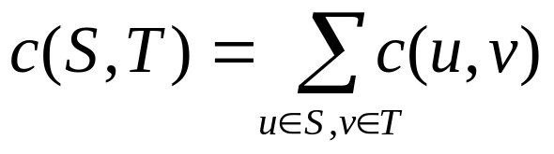
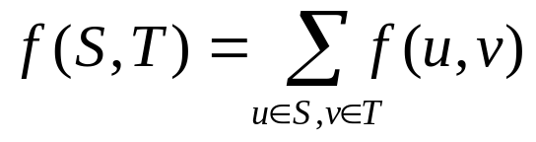
Cuts of flow networks
Definition 9.7 A cut (S,T) of a flow network G=(V,E) is a partiton of V into S and T=V-S such that s∈S and t∈T. The capacity of the cut {S,T},denoted by c(S,T), is
The flow across the cut {S,T} is
v₁
12/12
v₃
11/16
19/20
S = {s,v₁,v₂) , T = {v₃,v₄,t}
10
1/4
7/7
_{s}
0/9
t
4/4
12/13
v₂
v₄
11/14
Notes:
The net flow across the cut and the capacity of the cut
normally functions like f take as arguments two vertices in a flow network, if one or both arguments are sets of vertices we interpret that as the sum of all possible ways of replacing the arguments with their members.
Note/observe that we can have a net flow below 0 but all capacities are all composed of nonnegative values

Slide 34
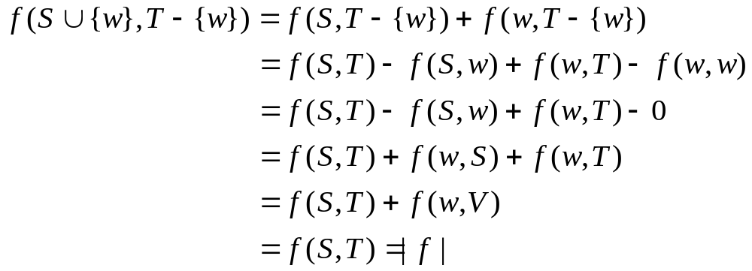
Cuts of flow networks
Lemma 9.3 For any cut {S,T} and a flow f, f (S ,T) = | f |
Proof. By induction on the number of vertices in S. If S={s}, then it is true by definition. Assume it is true for the cut {S,T}. We show that it also holds for the cut {S∪{w}, T -{w}} for w∈T-{t}, in fact,
v₁
12/12
v₃
11/16
19/20
10
1/4
7/7
s
0/9
t
12/13
4/4
v₂
v₄
11/14

Slide 35
Cuts of flow networks
Assumption:
The value of any flow f in a flow network G is bounded from above by the capacity of any cut of G
Corollary 9.2 | f | < c (S, T)
Proof. | f | = f (S, T)
= Σ Σ f (u, v)
< Σ Σ c (u, v)
= c (S, T)
v₁
12/12
v₃
11/16
19/20
10
1/4
7/7
s
0/9
t
u∈S
v∈T
4/4
12/13
v₂
v₄
u∈S
v∈T
11/14

Slide 36
Max-flow min-cut theorem
Theorem 9.1 If f is a flow in a flow network G = (V,E) with source s and sink t, then the following conditions are equivalent:
| f | = c (S, T) for some cut (S, T) of G.
2. f is a maximum flow in G.
3. The residual network G_{f} contains no augmenting paths.
proof:
⇒ (2):
As proofed before | f | = f (S, T) < c (S, T) for any cut {S,T}, | f | = c (S, T) implies that f is a maximum flow

Slide 37
Max-flow min-cut theorem
Theorem 9.1 If f is a flow in a flow network G = (V,E) with source s and sink t, then the following conditions are equivalent:
| f | = c (S, T) for some cut (S, T) of G.
f is a maximum flow in G.
The residual network G_{f} contains no augmenting paths.
proof: (2) ⇒ (3):
We assume for the sake of contradiction that f is a maximum flow in G but that there still exists an augmenting path p in G_{f}.
Then as we know from above, we can augment the flow in G according to the formula: f´= f + f_{p}. That would create a flow f´ that is strictly greater than the former flow f which is in contradiction to our assumption that f is a maximum flow.

Slide 38
Max-flow min-cut theorem
Theorem 9.1 If f is a flow in a flow network G = (V,E) with source s and sink t, then the following conditions are equivalent:
| f | = c (S, T) for some cut (S, T) of G.
f is a maximum flow in G.
The residual network G_{f} contains no augmenting paths.
proof:
(3) ⇒ (1):
original flow network G
residual network G_{f}
3/3
3
v₁
v₃
v₁
v₃
6/8
4/6
2
3/3
2
3
6
4
s
t
s
1
t
1/3
2
6/6
6
5
8/8
8
v₂
v₄
v₂
v₄
5/6
1
Notes:
Gf contains no augmenting path means that Gf contains no path from s to t.

Slide 39
Max-flow min-cut theorem
Theorem 9.1 If f is a flow in a flow network G = (V,E) with source s and sink t, then the following conditions are equivalent:
| f | = c (S, T) for some cut (S, T) of G.
f is a maximum flow in G.
The residual network G_{f} contains no augmenting paths.
proof:
(3) ⇒ (1): Define
S = {v ∈V | ∃ path p from s to v in G_{f} }
T = V - S
residual network G_{f}
3
v₃
v₁
2
2
3
6
4
s
1
t
2
6
5
G_{f} contains no edges from S to T
v₂
v₄
8
1
Notes:
We suppose that Gf has no augmenting path according to 2, that is that Gf contains no path from s to t.
We define a set S which contains the source s and all from s reachable vertices v in Gf.
T will be the complementary set of S in V. Then this partition will be a cut, as t cannot be an element of S according to 2.

Slide 40
Max-flow min-cut theorem
Theorem 9.1 If f is a flow in a flow network G = (V,E) with source s and sink t, then the following conditions are equivalent:
| f | = c (S, T) for some cut (S, T) of G.
f is a maximum flow in G.
The residual network G_{f} contains no augmenting paths.
Continue:
All edges from S to T are saturated,
Namely, for ∀ u ∈ S, v ∈ T: f (u, v) = c (u, v) (otherwise (u, v) ∈ E_{f} and v ∈S)
| f | = f (S, T) = c (S, T)
original network G
3/3
v₁
v₃
6/8
4/6
3/3
s
t
1/3
6/6
v₂
v₄
8/8
5/6
Notes:
The connecting vertices of S and T must all have a maximum flow, we call these edges critical edges.
As all edges are critical edges the flow over our cut must be maximum and therefore equal to the capacity of our cut.
As we know from before the flow in the network equals the flow over any cut and equals in our example als the capacity of our cut.
Therefore we have proofed the implication of 2 to 3.

Slide 41
Ford-Fulkerson algorithm
FordFulkerson(G, s, t, c)
1 for each edge (u,v) ∈E do
2 f (u,v) ←0
3 G_{f} ← G
4 while there is an augmenting path p in G_{f} do
5 Let c_{f} (p) be the bottleneck capacity of p
6 for each edge (u,v) in p do
7 f (u,v) ← f (u,v)+ c_{f} (p)
8 Update the residual graph G_{f}

Slide 42
Example of an execution
Residual network G_{f}
v₁
12
v₃
16
20
10
4
7
s
9
t
FordFulkerson(G, s, t, c)
1 for each edge (u,v) ∈E do
2 f (u,v) ←0
3 G_{f} ← G
4 while there is an augmenting path p in G_{f} do
5 Let c_{f} (p) be the bottleneck capacity of p
6 for each edge (u,v) in p do
7 f (u,v) ← f (u,v)+ c_{f} (p)
8 Update the residual graph G_{f}
4
13
v₂
v₄
14

Slide 43
Example of an execution
Residual network G_{f}
v₁
0/12
v₃
0/16
0/20
0/10
0/4
0/7
FordFulkerson(G, s, t, c)
1 for each edge (u,v) ∈E do
2 f (u,v) ←0
3 G_{f} ← G
4 while there is an augmenting path p in G_{f} do
5 Let c_{f} (p) be the bottleneck capacity of p
6 for each edge (u,v) in p do
7 f (u,v) ← f (u,v)+ c_{f} (p)
8 Update the residual graph G_{f}
s
0/9
t
0/4
0/13
v₂
v₄
0/14

Slide 44
Example of an execution
Residual network G_{f}
v₁
12
v₃
16
20
10
4
7
s
9
t
FordFulkerson(G, s, t, c)
1 for each edge (u,v) ∈E do
2 f (u,v) ←0
3 G_{f} ← G
4 while there is an augmenting path p in G_{f} do
5 Let c_{f} (p) be the bottleneck capacity of p
6 for each edge (u,v) in p do
7 f (u,v) ← f (u,v)+ c_{f} (p)
8 Update the residual graph G_{f}
4
13
v₂
v₄
14

Slide 45
Example of an execution
Residual network G_{f}
FordFulkerson(G, s, t, c)
1 for each edge (u,v) ∈E do
2 f (u,v) ←0
3 G_{f} ← G
4 while there is an augmenting path p in G_{f} do
5 Let c_{f} (p) be the bottleneck capacity of p
6 for each edge (u,v) in p do
7 f (u,v) ← f (u,v)+ c_{f} (p)
8 Update the residual graph G_{f}
v₁
12
v₃
16
20
10
4
7
s
9
t
4
13
v₂
v₄
14
bottleneck capacity:
c_{f}(p) = 12

Slide 46
Example of an execution
Residual network G_{f}
FordFulkerson(G, s, t, c)
1 for each edge (u,v) ∈E do
2 f (u,v) ←0
3 G_{f} ← G
4 while there is an augmenting path p in G_{f} do
5 Let c_{f} (p) be the bottleneck capacity of p
6 for each edge (u,v) in p do
7 f (u,v) ← f (u,v)+ c_{f} (p)
8 Update the residual graph G_{f}
v₁
12
v₃
16
20
10
4
7
s
9
t
4
13
v₂
v₄
14
New flow network G
v₁
12/12
v₃
12/16
12/20
10
4
7
bottleneck capacity:
c_{f}(p) = 12
s
9
t
4
13
v₂
v₄
14

Slide 47
Example of an execution
New flow network G
FordFulkerson(G, s, t, c)
1 for each edge (u,v) ∈E do
2 f (u,v) ←0
3 G_{f} ← G
4 while there is an augmenting path p in G_{f} do
5 Let c_{f} (p) be the bottleneck capacity of p
6 for each edge (u,v) in p do
7 f (u,v) ← f (u,v)+ c_{f} (p)
8 Update the residual graph G_{f}
v₁
12/12
v₃
12/16
12/20
10
4
7
s
9
t
4
13
v₂
v₄
14
Residual network G_{f}
v₁
12
v₃
4
8
12
bottleneck capacity:
c_{f}(p) = 12
10
4
12
7
s
9
t
4
13
v₂
v₄
14

Slide 48
Example of an execution
Residual network G_{f}
FordFulkerson(G, s, t, c)
1 for each edge (u,v) ∈E do
2 f (u,v) ←0
3 G_{f} ← G
4 while there is an augmenting path p in G_{f} do
5 Let c_{f} (p) be the bottleneck capacity of p
6 for each edge (u,v) in p do
7 f (u,v) ← f (u,v)+ c_{f} (p)
8 Update the residual graph G_{f}
v₁
12
v₃
4
8
12
12
10
4
7
s
9
t
4
13
v₂
v₄
14
Residual network G_{f}
v₁
12
v₃
4
8
12
12
10
4
7
s
9
t
4
13
v₂
v₄
14

Slide 49
Example of an execution
Residual network G_{f}
FordFulkerson(G, s, t, c)
1 for each edge (u,v) ∈E do
2 f (u,v) ←0
3 G_{f} ← G
4 while there is an augmenting path p in G_{f} do
5 Let c_{f} (p) be the bottleneck capacity of p
6 for each edge (u,v) in p do
7 f (u,v) ← f (u,v)+ c_{f} (p)
8 Update the residual graph G_{f}
v₁
12
v₃
4
8
12
12
10
4
7
s
9
t
4
13
v₂
v₄
14
New flow network G
v₁
12/12
v₃
12/16
12/20
10
4
7
bottleneck capacity:
c_{f}(p) = 4
s
9
t
4
13
v₂
v₄
14

Slide 50
Example of an execution
Residual network G_{f}
FordFulkerson(G, s, t, c)
1 for each edge (u,v) ∈E do
2 f (u,v) ←0
3 G_{f} ← G
4 while there is an augmenting path p in G_{f} do
5 Let c_{f} (p) be the bottleneck capacity of p
6 for each edge (u,v) in p do
7 f (u,v) ← f (u,v)+ c_{f} (p)
8 Update the residual graph G_{f}
v₁
12
v₃
4
8
12
12
10
4
7
s
9
t
4
13
v₂
v₄
14
New flow network G
v₁
12/12
v₃
12/16
12/20
10
4
7
bottleneck capacity:
c_{f}(p) =4
s
9
t
4/4
4/13
v₂
v₄
4/14

Slide 51
Example of an execution
Residual network G_{f}
FordFulkerson(G, s, t, c)
1 for each edge (u,v) ∈E do
2 f (u,v) ←0
3 G_{f} ← G
4 while there is an augmenting path p in G_{f} do
5 Let c_{f} (p) be the bottleneck capacity of p
6 for each edge (u,v) in p do
7 f (u,v) ← f (u,v)+ c_{f} (p)
8 Update the residual graph G_{f}
v₁
12
v₃
4
8
12
12
10
4
7
s
9
t
4
4
4
9
v₂
v₄
10
New flow network G
v₁
12/12
v₃
12/16
12/20
10
4
7
s
9
t
4/4
4/13
v₂
v₄
4/14

Slide 52
Example of an execution
Residual network G_{f}
FordFulkerson(G, s, t, c)
1 for each edge (u,v) ∈E do
2 f (u,v) ←0
3 G_{f} ← G
4 while there is an augmenting path p in G_{f} do
5 Let c_{f} (p) be the bottleneck capacity of p
6 for each edge (u,v) in p do
7 f (u,v) ← f (u,v)+ c_{f} (p)
8 Update the residual graph G_{f}
v₁
12
v₃
4
8
12
12
10
4
7
s
9
t
4
4
4
9
v₂
v₄
10
New flow network G
v₁
12/12
v₃
12/16
12/20
10
4
7
s
9
t
4/4
4/13
v₂
v₄
4/14

Slide 53
Example of an execution
Residual network G_{f}
FordFulkerson(G, s, t, c)
1 for each edge (u,v) ∈E do
2 f (u,v) ←0
3 G_{f} ← G
4 while there is an augmenting path p in G_{f} do
5 Let c_{f} (p) be the bottleneck capacity of p
6 for each edge (u,v) in p do
7 f (u,v) ← f (u,v)+ c_{f} (p)
8 Update the residual graph G_{f}
v₁
12
v₃
4
8
12
12
10
4
7
s
9
t
4
4
4
9
v₂
v₄
10
New flow network G
v₁
12/12
v₃
12/16
12/20
10
4
7
bottleneck capacity:
c_{f}(p) = 7
s
9
t
4/4
4/13
v₂
v₄
4/14

Slide 54
Example of an execution
Residual network G_{f}
FordFulkerson(G, s, t, c)
1 for each edge (u,v) ∈E do
2 f (u,v) ←0
3 G_{f} ← G
4 while there is an augmenting path p in G_{f} do
5 Let c_{f} (p) be the bottleneck capacity of p
6 for each edge (u,v) in p do
7 f (u,v) ← f (u,v)+ c_{f} (p)
8 Update the residual graph G_{f}
v₁
12
v₃
4
8
12
12
10
4
7
s
9
t
4
4
4
9
v₂
v₄
10
New flow network G
v₁
12/12
v₃
12/16
19/20
10
4
7/7
bottleneck capacity:
c_{f}(p) = 7
s
9
t
4/4
11/13
v₂
v₄
11/14

Slide 55
Example of an execution
Residual network G_{f}
FordFulkerson(G, s, t, c)
1 for each edge (u,v) ∈E do
2 f (u,v) ←0
3 G_{f} ← G
4 while there is an augmenting path p in G_{f} do
5 Let c_{f} (p) be the bottleneck capacity of p
6 for each edge (u,v) in p do
7 f (u,v) ← f (u,v)+ c_{f} (p)
8 Update the residual graph G_{f}
v₁
12
v₃
4
1
12
19
10
4
7
s
9
t
11
11
4
2
v₂
v₄
3
New flow network G
v₁
12/12
v₃
12/16
19/20
10
4
7/7
s
9
t
4/4
11/13
v₂
v₄
11/14

Slide 56
Example of an execution
Residual network G_{f}
FordFulkerson(G, s, t, c)
1 for each edge (u,v) ∈E do
2 f (u,v) ←0
3 G_{f} ← G
4 while there is an augmenting path p in G_{f} do
5 Let c_{f} (p) be the bottleneck capacity of p
6 for each edge (u,v) in p do
7 f (u,v) ← f (u,v)+ c_{f} (p)
8 Update the residual graph G_{f}
v₁
12
v₃
4
1
12
19
10
4
7
s
9
t
11
11
4
2
v₂
v₄
3
New flow network G
v₁
12/12
v₃
12/16
19/20
10
4
7/7
Finally we have:
| f | = f (s, V) = 23
s
9
t
4/4
11/13
v₂
v₄
11/14

Slide 57
Analysis of the Ford Fulkerson algorithm
FordFulkerson(G, s, t, c)
1 for each edge (u,v) ∈E do
2 f (u,v) ←0
3 G_{f} ← G
4 while there is an augmenting path p in G_{f} do
5 Let c_{f} (p) be the bottleneck capacity of p
6 for each edge (u,v) in p do
7 f (u,v) ← f (u,v)+ c_{f} (p)
8 Update the residual graph G_{f}
The running time depends on how the augmenting path p in line 4 is determined.

Slide 58
Analysis of the Ford Fulkerson algorithm
FordFulkerson(G, s, t, c)
1 for each edge (u,v) ∈E do
2 f (u,v) ←0
3 G_{f} ← G
4 while there is an augmenting path p in G_{f} do
5 Let c_{f} (p) be the bottleneck capacity of p
6 for each edge (u,v) in p do
7 f (u,v) ← f (u,v)+ c_{f} (p)
8 Update the residual graph G_{f}
O(|E|)
O(|E|)
O(|E|)
O(|E| |f_{max}|)
O(|E|)
O(|E|)
running time: O( |E| |f_{max}| ) with f_{max} as maximum flow
Notes: The augmenting path is chosen arbitrarily and all capacities are integers
Notes:
breath first search or depth first search

Slide 59
Analysis of the Ford Fulkerson algorithm
Running time (arbitrary choice of p)
Consequencies of an arbitrarily choice:
Example if |f*| is large:
v₁
v₁
10000
10000
10000
10000
s
1
t
s
1
t
10000
10000
10000
v₂
v₂
10000
running time: O( |E| |f_{max}| ) with f_{max} as maximum flow
Notes: The augmenting path is chosen arbitrarily and all capacities are integers

Slide 60
Analysis of the Ford Fulkerson algorithm
Running time (arbitrary choice of p)
Consequencies of an arbitrarily choice:
Example if | f*| is large:
residual network G_{f}
v₁
v₁
1 / 10000
10000
9999
10000
1
s
1 / 1
t
s
1
t
1
10000
1 / 10000
10000
9999
v₂
v₂
running time: O(|E| |f_{max}|) with f_{max} as maximum flow

Slide 61
Analysis of the Ford Fulkerson algorithm
Running time (arbitrary choice of p)
Consequencies of an arbitrarily choice:
Example if | f*| is large:
residual network G_{f}
v₁
v1
10000
1 / 10000
1/10000
9999
1
1/1
1
t
s
t
s
1
10000
9999
1/10000
1 / 10000
v₂
v2
running time: O(|E| |f_{max}|) with f_{max} as maximum flow

Slide 62
Analysis of the Ford Fulkerson algorithm
Running time (arbitrary choice of p)
Consequencies of an arbitrarily choice:
Example if | f*| is large:
v₁
Running time: excute 20000 times
9999
9999
1
1
s
1
t
1
1
9999
9999
v₂
running time: O(|E| |f_{max}|) with f_{max} as maximum flow

Slide 63
Shortest Path Augmentation Method
Definition 9.8 The level of a vertex v, denoted by d(v), is the least number of edges in a path from s to v. Given a directed graph G=(V,E), the level graph G_{L} is (V, E´), where E´={(u,v): d(v)=d(u)+1}
12
v₁
12
v₃
v₁
v₃
20
16
20
16
4
s
t
s
10
9
7
t
13
4
13
4
v₂
v₄
v₂
v₄
14
14
directed graph G=(V,E)
level graph G_{L}

Slide 64
Shortest path augmentation method:
Select an augmenting path of minimum length and increases the current flow by an amount equal to the bottleneck capacity of that path. The algorithm starts by initializing the flow to the zero flow and setting the residual graph G_{f} to the original network. It then proceeds in phased. Each phase consists of the following two steps.
  1 Compute the level graph G_{L} from the residual graph G_{f} . If t is not in G_{L}, then halt: otherwise continue.
  2 As long as there is a path p form s to t in G_{L}, augment the current flow by p, remove saturated edges from G_{L} and G_{f} update them accordingly.

Slide 65
ShortestPathAugmentation( G, s, t)
1 for each edge (u,v) ∈E do
2 f(u,v) ←0
3 G_{f} ← G
4 find the level graph G_{L} of G_{f}
5 while t is a vertex in G_{L} do
6 while there is a path p from s to t in G_{L} do
7 let c_{f} (p) be the bottleneck capacity on p
8 augment the current flow f by c_{f} (p)
9 update G_{L} and G_{f} along the path p
10 use G_{f} to compute a new level graph G_{L}

Slide 66
Example of an execution
v₁
12
v₃
ShortestPathAugmentation( G, s, t)
1 for each edge (u,v) ∈E do
2 f(u,v) ←0
3 G_{f} ← G
4 find the level graph G_{L} of G_{f}
5 while t is a vertex in G_{L} do
6 while there is a path p from s to t in G_{L} do
7 let c_{f} (p) be the bottleneck capacity on p
8 augment the current flow f by c_{f} (p)
9 update G_{L} and G_{f} along the path p
10 use G_{f} to compute a new level graph G_{L}
16
20
4
s
10
9
7
t
13
4
v₂
v₄
14
Input graph G=(V,E)
v₁
0/12
v₃
0/16
0/20
0/4
s
0/10
0/9
0/7
t
0/13
0/4
v₂
v₄
0/14
Input graph G=(V,E)

Slide 67
Example of an execution
v₁
12
v₃
ShortestPathAugmentation( G, s, t)
1 for each edge (u,v) ∈E do
2 f(u,v) ←0
3 G_{f} ← G
4 find the level graph G_{L} of G_{f}
5 while t is a vertex in G_{L} do
6 while there is a path p from s to t in G_{L} do
7 let c_{f} (p) be the bottleneck capacity on p
8 augment the current flow f by c_{f} (p)
9 update G_{L} and G_{f} along the path p
10 use G_{f} to compute a new level graph G_{L}
16
20
4
s
10
9
7
t
13
4
v₂
v₄
14
Residual graph
v₁
12
v₃
16
20
s
t
13
4
v₂
v₄
14
level graph G_{L}

Slide 68
Example of an execution
ShortestPathAugmentation( G, s, t)
1 for each edge (u,v) ∈E do
2 f(u,v) ←0
3 G_{f} ← G
4 find the level graph G_{L} of G_{f}
5 while t is a vertex in G_{L} do
6 while there is a path p from s to t in G_{L} do
7 let c_{f} (p) be the bottleneck capacity on p
8 augment the current flow f by c_{f} (p)
9 update G_{L} and G_{f} along the path p
10 use G_{f} to compute a new level graph G_{L}
v₁
12
v₃
16
20
s
t
13
4
v₂
v₄
14
level graph G_{L}

Slide 69
Example of an execution
ShortestPathAugmentation( G, s, t)
1 for each edge (u,v) ∈E do
2 f(u,v) ←0
3 G_{f} ← G
4 find the level graph G_{L} of G_{f}
5 while t is a vertex in G_{L} do
6 while there is a path p from s to t in G_{L} do
7 let c_{f} (p) be the bottleneck capacity on p
8 augment the current flow f by c_{f} (p)
9 update G_{L} and G_{f} along the path p
10 use G_{f} to compute a new level graph G_{L}
v₁
12
v₃
16
20
s
t
13
4
v₂
v₄
14
level graph G_{L}

Slide 70
Example of an execution
ShortestPathAugmentation( G, s, t)
1 for each edge (u,v) ∈E do
2 f(u,v) ←0
3 G_{f} ← G
4 find the level graph G_{L} of G_{f}
5 while t is a vertex in G_{L} do
6 while there is a path p from s to t in G_{L} do
7 let c_{f} (p) be the bottleneck capacity on p
8 augment the current flow f by c_{f} (p)
9 update G_{L} and G_{f} along the path p
10 use G_{f} to compute a new level graph G_{L}
v₁
12
v₃
16
20
s
t
13
4
v₂
v₄
14
level graph G_{L}

Slide 71
Example of an execution
ShortestPathAugmentation( G, s, t)
1 for each edge (u,v) ∈E do
2 f(u,v) ←0
3 G_{f} ← G
4 find the level graph G_{L} of G_{f}
5 while t is a vertex in G_{L} do
6 while there is a path p from s to t in G_{L} do
7 let c_{f} (p) be the bottleneck capacity on p
8 augment the current flow f by c_{f} (p)
9 update G_{L} and G_{f} along the path p
10 use G_{f} to compute a new level graph G_{L}
v₁
12/12
v₃
12/16
12/20
s
t
13
4
v₂
v₄
14
level graph G_{L}

Slide 72
Example of an execution
v₁
v₃
12
8
ShortestPathAugmentation( G, s, t)
1 for each edge (u,v) ∈E do
2 f(u,v) ←0
3 G_{f} ← G
4 find the level graph G_{L} of G_{f}
5 while t is a vertex in G_{L} do
6 while there is a path p from s to t in G_{L} do
7 let c_{f} (p) be the bottleneck capacity on p
8 augment the current flow f by c_{f} (p)
9 update G_{L} and G_{f} along the path p
10 use G_{f} to compute a new level graph G_{L}
4
12
12
4
s
10
9
7
t
13
4
v₂
v₄
14
Residual graph
v₁
4
s
t
13
4
v₂
v₄
14
level graph G_{L}

Slide 73
Example of an execution
ShortestPathAugmentation( G, s, t)
1 for each edge (u,v) ∈E do
2 f(u,v) ←0
3 G_{f} ← G
4 find the level graph G_{L} of G_{f}
5 while t is a vertex in G_{L} do
6 while there is a path p from s to t in G_{L} do
7 let c_{f} (p) be the bottleneck capacity on p
8 augment the current flow f by c_{f} (p)
9 update G_{L} and G_{f} along the path p
10 use G_{f} to compute a new level graph G_{L}
v₁
4
s
t
13
4
v₂
v₄
14
level graph G_{L}

Slide 74
Example of an execution
ShortestPathAugmentation( G, s, t)
1 for each edge (u,v) ∈E do
2 f(u,v) ←0
3 G_{f} ← G
4 find the level graph G_{L} of G_{f}
5 while t is a vertex in G_{L} do
6 while there is a path p from s to t in G_{L} do
7 let c_{f} (p) be the bottleneck capacity on p
8 augment the current flow f by c_{f} (p)
9 update G_{L} and G_{f} along the path p
10 use G_{f} to compute a new level graph G_{L}
v₁
4
s
t
13
4
v₂
v₄
14
level graph G_{L}

Slide 75
Example of an execution
ShortestPathAugmentation( G, s, t)
1 for each edge (u,v) ∈E do
2 f(u,v) ←0
3 G_{f} ← G
4 find the level graph G_{L} of G_{f}
5 while t is a vertex in G_{L} do
6 while there is a path p from s to t in G_{L} do
7 let c_{f} (p) be the bottleneck capacity on p
8 augment the current flow f by c_{f} (p)
9 update G_{L} and G_{f} along the path p
10 use G_{f} to compute a new level graph G_{L}
v₁
4
s
t
4/13
4/4
v₂
v₄
4/14
level graph G_{L}

Slide 76
Example of an execution
v₁
v₃
12
8
ShortestPathAugmentation( G, s, t)
1 for each edge (u,v) ∈E do
2 f(u,v) ←0
3 G_{f} ← G
4 find the level graph G_{L} of G_{f}
5 while t is a vertex in G_{L} do
6 while there is a path p from s to t in G_{L} do
7 let c_{f} (p) be the bottleneck capacity on p
8 augment the current flow f by c_{f} (p)
9 update G_{L} and G_{f} along the path p
10 use G_{f} to compute a new level graph G_{L}
4
12
12
4
s
10
9
7
t
4
4
9
4
v₂
v₄
10
Residual graph
v₁
v₃
4
8
s
7
t
9
v₂
v₄
10
level graph G_{L}

Slide 77
Example of an execution
ShortestPathAugmentation( G, s, t)
1 for each edge (u,v) ∈E do
2 f(u,v) ←0
3 G_{f} ← G
4 find the level graph G_{L} of G_{f}
5 while t is a vertex in G_{L} do
6 while there is a path p from s to t in G_{L} do
7 let c_{f} (p) be the bottleneck capacity on p
8 augment the current flow f by c_{f} (p)
9 update G_{L} and G_{f} along the path p
10 use G_{f} to compute a new level graph G_{L}
v₁
v₃
4
8
s
7
t
9
v₂
v₄
10
level graph G_{L}

Slide 78
Example of an execution
ShortestPathAugmentation( G, s, t)
1 for each edge (u,v) ∈E do
2 f(u,v) ←0
3 G_{f} ← G
4 find the level graph G_{L} of G_{f}
5 while t is a vertex in G_{L} do
6 while there is a path p from s to t in G_{L} do
7 let c_{f} (p) be the bottleneck capacity on p
8 augment the current flow f by c_{f} (p)
9 update G_{L} and G_{f} along the path p
10 use G_{f} to compute a new level graph G_{L}
v₁
v₃
4
8
s
7
t
9
v₂
v₄
10
level graph G_{L}

Slide 79
Example of an execution
ShortestPathAugmentation( G, s, t)
1 for each edge (u,v) ∈E do
2 f(u,v) ←0
3 G_{f} ← G
4 find the level graph G_{L} of G_{f}
5 while t is a vertex in G_{L} do
6 while there is a path p from s to t in G_{L} do
7 let c_{f} (p) be the bottleneck capacity on p
8 augment the current flow f by c_{f} (p)
9 update G_{L} and G_{f} along the path p
10 use G_{f} to compute a new level graph G_{L}
v₁
v₃
4
7/8
s
7/7
t
7/9
v₂
v₄
7/10
level graph G_{L}

Slide 80
Example of an execution
v₁
v₃
12
1
ShortestPathAugmentation( G, s, t)
1 for each edge (u,v) ∈E do
2 f(u,v) ←0
3 G_{f} ← G
4 find the level graph G_{L} of G_{f}
5 while t is a vertex in G_{L} do
6 while there is a path p from s to t in G_{L} do
7 let c_{f} (p) be the bottleneck capacity on p
8 augment the current flow f by c_{f} (p)
9 update G_{L} and G_{f} along the path p
10 use G_{f} to compute a new level graph G_{L}
4
12
19
4
s
10
9
7
t
11
4
2
11
v₂
v₄
3
Residual graph
v₁
4
s
t
2
v₂
v₄
3
level graph G_{L}

Slide 81
Example of an execution
v₁
ShortestPathAugmentation( G, s, t)
1 for each edge (u,v) ∈E do
2 f(u,v) ←0
3 G_{f} ← G
4 find the level graph G_{L} of G_{f}
5 while t is a vertex in G_{L} do
6 while there is a path p from s to t in G_{L} do
7 let c_{f} (p) be the bottleneck capacity on p
8 augment the current flow f by c_{f} (p)
9 update G_{L} and G_{f} along the path p
10 use G_{f} to compute a new level graph G_{L}
4
s
t
2
v₂
v₄
3
level graph G_{L}
v₁
12/12
v₃
12/16
19/20
0/4
s
0/10
9
7/7
t
Finally we have:
| f | = f (s, V) = 23
11/13
4/4
v₂
v₄
11/14
New flow network G

Slide 82
Analysis of ShortestPathAugmentation
algorithm
Lemma 9.4 The number of phases in the ShortestPathAugmentation algorithms is at most |V|.
Proof we show that the number of level graph computed using the algorithm is at most |V|.
First,we show that the squence of lengths of augmenting paths using ShortestPathAugmentation is strictly increasing. Let p be any augmenting path in the current G_{L}. After augmenting using p, at least one edge will be saturated and will disappear in G_{f}. At most |p| new edges will appear in G_{f},but they are back edges, and henve will not contribute to a shortest path from s to t. There can be at most |E| paths of length |p| since each time an edge in G_{L} disappear.
Notes:
unit distances

Slide 83
Continue...
When t is no longer reachable from s in G_{L}, any augmenting path must use a back edge or a cross edge, and hence must be of length strictly greater than |p|. Since the length of any augmenting path is between 1 and |V|-1, the number of level graphs use for augmentations is at most |V|-1. Since one more level graph is computed in which t does not appear,the total number of level graphs computed is at most |V|.

Slide 84
Theorem Given an flow network G=(V,E), the ShortestPathAugmentation algorithm finds a maximum flow in O(|V||E|²).
Proof. Since there can be at most |E| augmentations along paths of the same length, and since by lemma the number of level graphs computed that are used for augmenting is at most |V|-1,the number of augmenting steps is at most (|V|-1)|E|. Finding a shortest augmenting path in G_{L} takes O(|E|) time using breadth first search. Thus, the total time needed to compute all augmenting paths is O(|V||E|²). Computing each level graph takes O(|E|) using breadth-first search, and hence the total time required to compute all level graphs is O((|V||E|).

Slide 85
Homework
Page 172
9.1 9.3 9.4 9.6
Implement SPA

